Slide 1
Regression Modelling
3 MODELLING TECHNIQUE
SAMUEL NWAKOLAM

Slide 2
Example: LIC Housing Finance
Objective: To study the impact of interest component on principal component
Steps to be followed
Generate regression equation and outputs of the coefficients, t and p values, R-square value
Interpret and test the significance of the variable/s
Generate scatter plots
Line of Fit equation: Principal (Y) = m*Interest (X) + c
Test of significance: t-value > 2, and p-values < 0.05

Slide 3
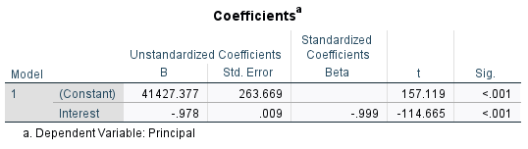

Line of fit equation and output
Line of fit eqn: Principal (Y) = 41427 - 0.9788 Interest(X)
Outputs
R-square: 0.998
Based on t and p values, both the Y-intercept and X (Interest), independent variable are SIGNIFICANT and they do impact the changes in Y (Principal) dependent variable

Slide 4
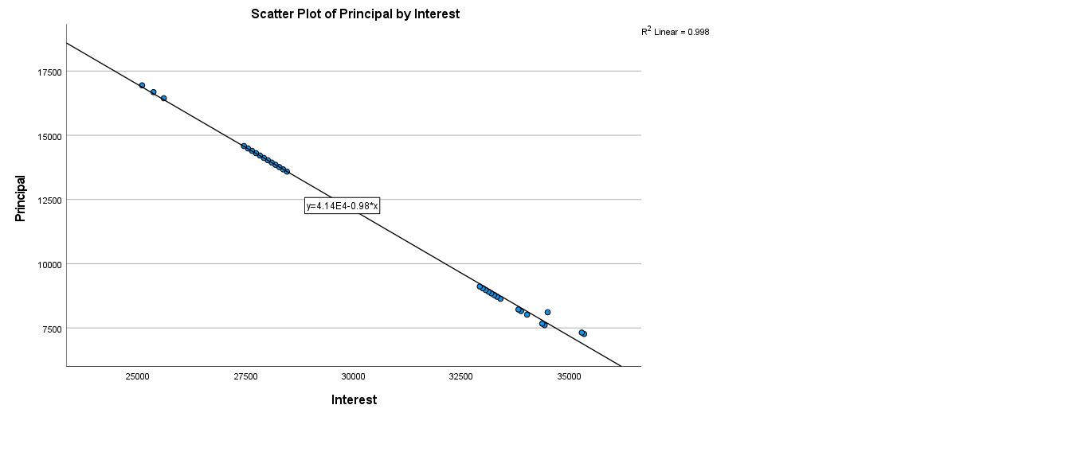
Scatter Plot Y (Principal) v/s X (Interest

Slide 5
Example – LIC (Interest change v/s PI ratio)
Objective: To study the impact of Interest change on PI ratio
Line of Fit equation: PI ratio (Y) = m*Interest change (X) + c
PI ratio (Y) = 0.00*intimp (X) + 0.386
Based on t and p values, interest impact is NOT SIGNIFICANT in bringing any changes to the PI ratio
Y- intercept is SIGNIFICANT
R-square = 0.004, which makes for ZERO correlation between interest impact and PI ratio

Slide 6
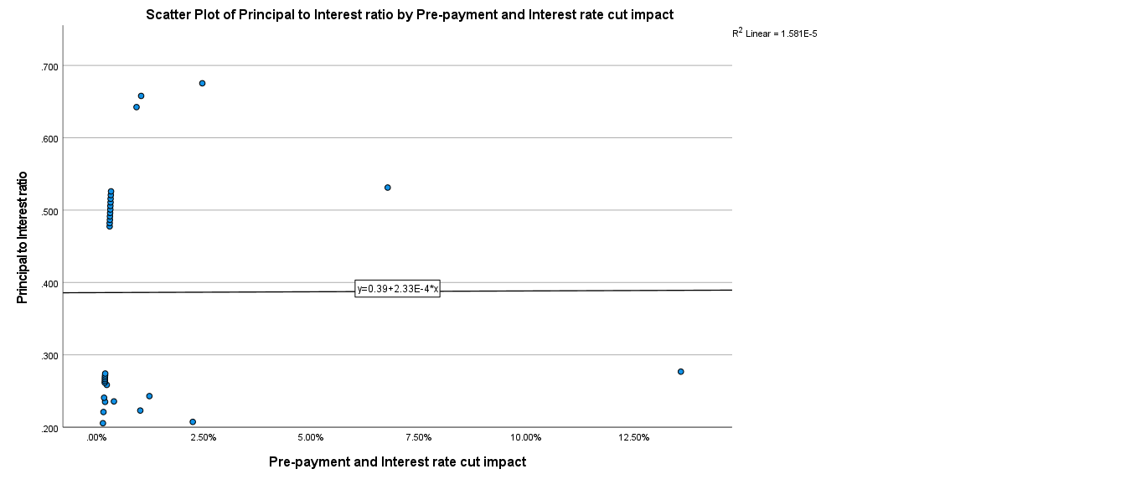

Slide 7
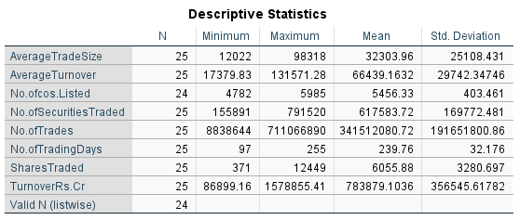

Slide 8
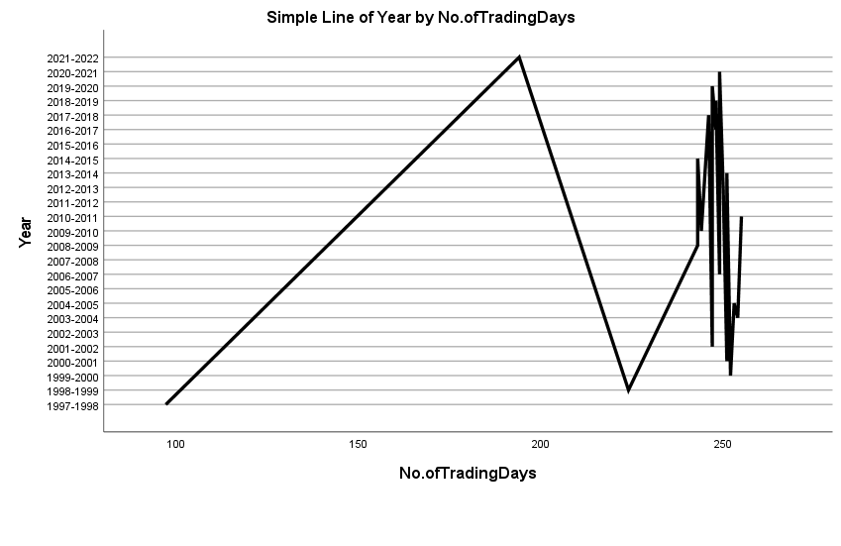
LINE CHART

Slide 9
Example : Market Summary
Objective: To study and assess if Avg. trade size and No. of Shares traded are correlated or not
Output
R = -0.612
Interpretation: Both variables are negatively correlated, and the negative correlation is strong
Conclusion: Both variables are negatively correlated
Variables | Avg. trade size | Shares traded
Avg. trade size | 1 | -0.612
Shares traded | -0.612 | 1

Slide 10
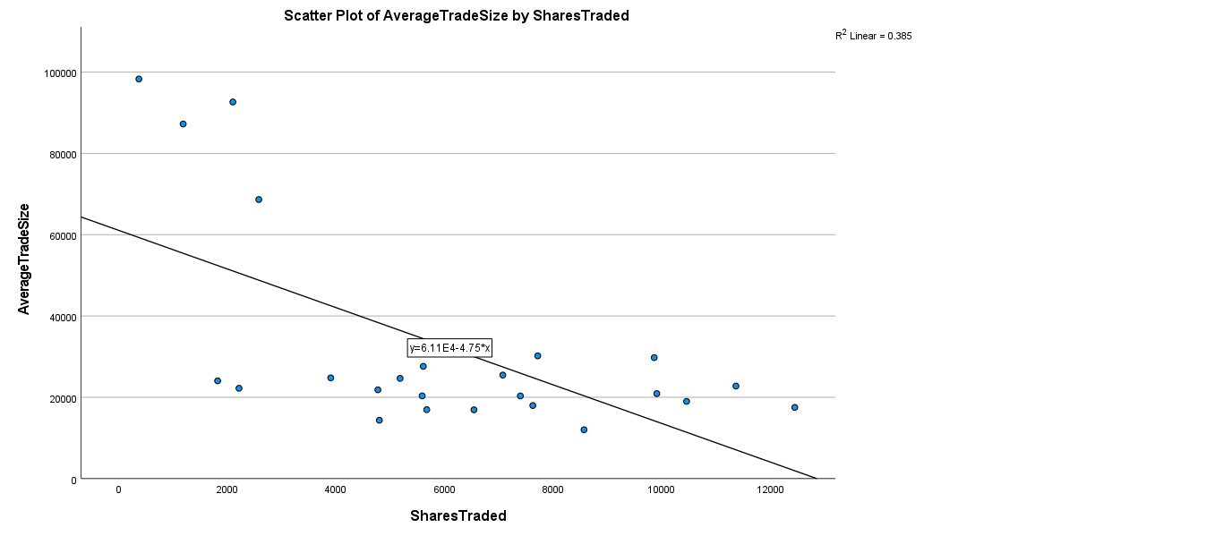

Slide 11
Line of fit equation and output
Line of fit eqn: Principal (Y) = 41427 - 0.9788 Interest(X)
Outputs
R-square: 0.998
Based on t and p values, both the Y-intercept and X (Interest), independent variable are SIGNIFICANT and they do impact the changes in Y (Principal) dependent variable

Slide 12
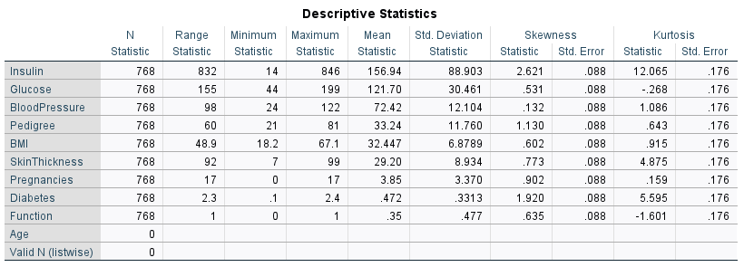

Slide 13
Example - Diabetes
Objective: To study and assess if Skin thickness and BMI are correlated or not
Outputs
R = 0.567 (Positive correlation)
Table
Interpretation: Variables BMI and Skin Thickness are POSITIVELY CORRELATED
Variables | BMI | Skin Thickness
BMI | 1 | 0.567
Skin Thickness | 0.567 | 1

Slide 14
